Slide 1
Soar and Construction Grammar
Peter Lindes, Deryle Lonsdale, David Embley
Brigham Young University
2014 Soar Workshop
© 2014 Peter Lindes

Slide 2
Goals
Long term goals
Build computational models of human language processing
Apply these models to real-world applications
OntoSoar project goals
Extract genealogy facts from family history books
Project extracted information onto a conceptual model to populate a searchable database

Slide 3
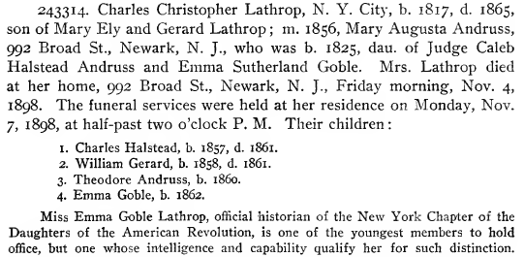
The Problem: Example 1

Slide 4
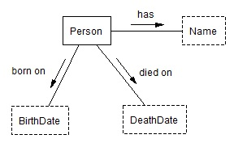
A Simple Ontology
has
Charles Christopher Lathrop
born on
died on
1817
1865

Slide 5
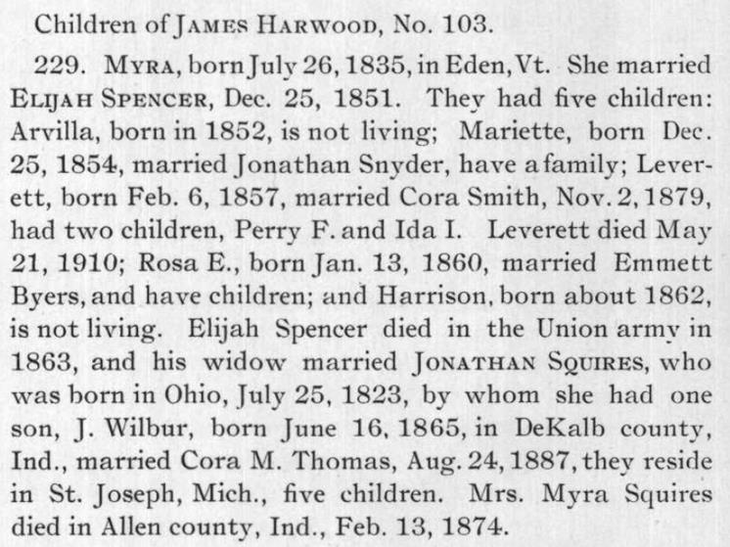
The Problem: Example2

Slide 6
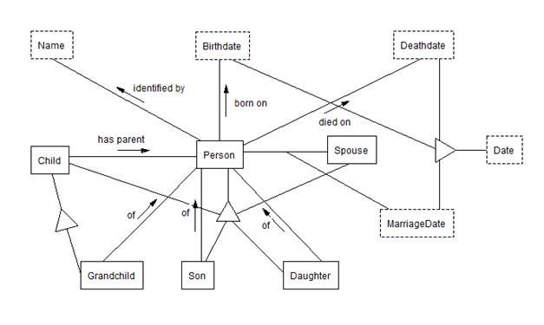
A More Complex Ontology
Myra Harwood
Feb. 13, 1874
Jonathan Squires
J. Wilbur Squires

Slide 7
Related Work
Link Grammar
Sleater & Temperley
Construction Grammar
Bergen & Chang, Bryant, Feldman
LG-Soar
Lonsdale et al.
OntoSoar
OntoES
Embley et al.
Soar
Newell, Laird
Theory
Melby, Lakoff, Johnson, Tomasello

Slide 8
The Solution
Thus, intelligence is the ability to bring to bear all the knowledge that one has in service of one’s goals.
Newell (1990), p. 90
Conceptual Models
World Knowledge
Pragmatics
Semantics
Syntax
Text Analysis
Page Layout *

Slide 9
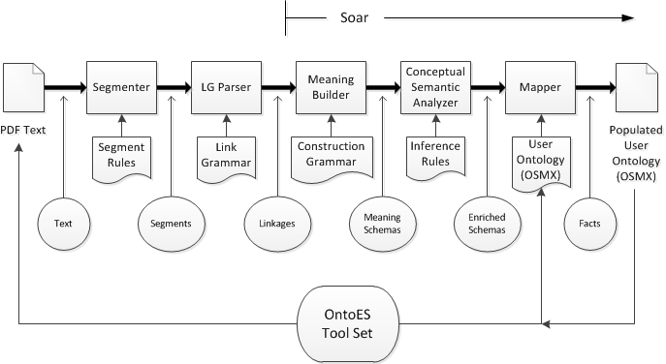
OntoSoar Architecture

Slide 10
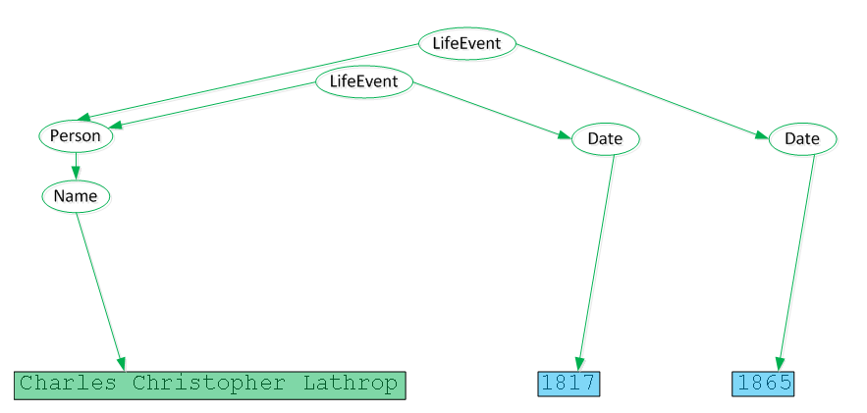
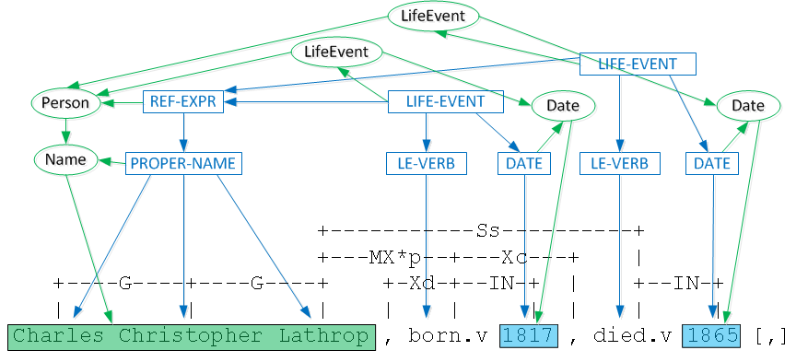
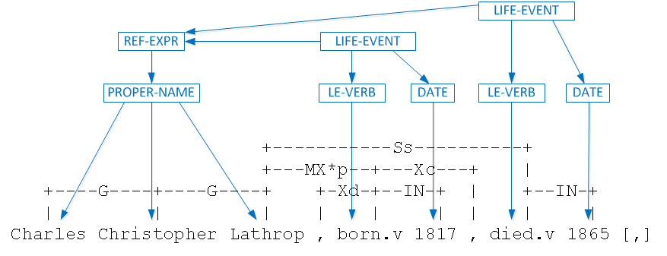
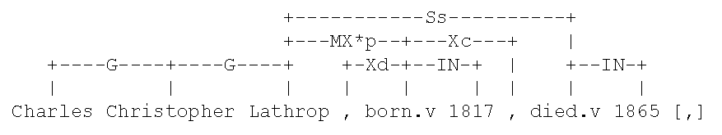
Applying Construction Grammar
Charles Christopher Lathrop, N. Y. City, b. 1817, d. 1865, son of Mary Ely and Gerard Lathrop ;

Slide 11
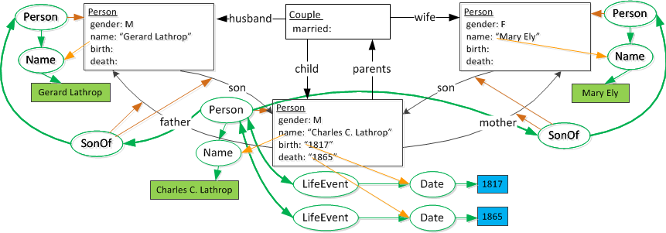
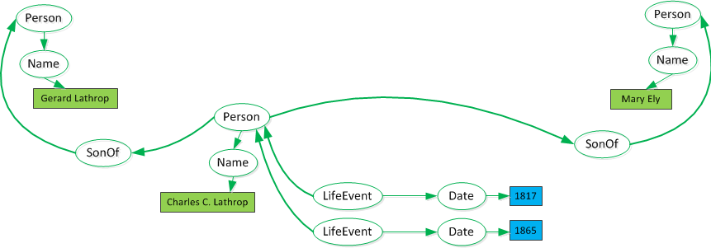
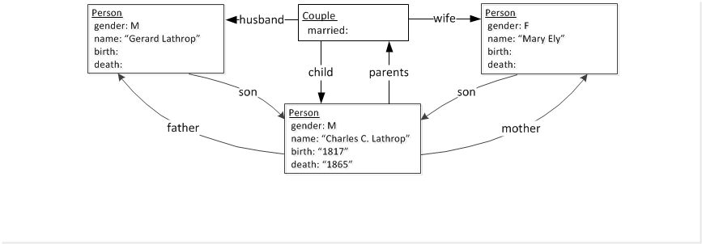
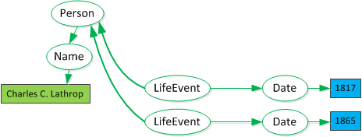
Building Meaning
Charles Christopher Lathrop, N. Y. City, b. 1817, d. 1865, son of Mary Ely and Gerard Lathrop ;

Slide 12
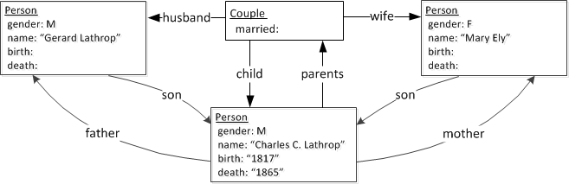
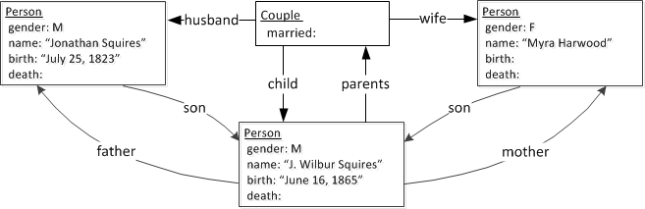
Meaning Structures Compared
Charles Christopher Lathrop, N. Y. City, b. 1817, d. 1865, son of Mary Ely and Gerard Lathrop ;
… his widow married JONATHAN SQUIRES, who was born in Ohio, July 25, 1823, by whom she had one son, J. Wilbur, born June 16, 1865,

Slide 13
Output Example
2: Charles Christopher Lathrop, N. Y. City, born 1817, died 1865, son of Mary Ely and Gerard Lathrop ; ';'
Facts extracted:
Reporting 8 objects:
X2: Name(osmx327, "Charles Christopher Lathrop")
X1: Son(osmx331)
X1: Person(osmx331)
X4: Name(osmx336, "Mary Ely")
X3: Person(osmx339)
X6: Name(osmx342, "Gerard Lathrop")
X5: Person(osmx345)
X7: Date(osmx349, "1817")
X7: BirthDate(osmx349, "1817")
X8: Date(osmx354, "1865")
X8: DeathDate(osmx354, "1865")
Reporting 7 relations:
Y1(osmx359): Person(osmx331) identified by Name(osmx327)
Y2(osmx362): Person(osmx339) identified by Name(osmx336)
Y3(osmx365): Person(osmx345) identified by Name(osmx342)
Y4(osmx368): Person(osmx331) born on BirthDate(osmx349)
Y5(osmx371): Person(osmx331) died on DeathDate(osmx354)
Y7(osmx374): Son(osmx331) of Person(osmx345)
Y6(osmx377): Son(osmx331) of Person(osmx339)
3: GP married 1856, Mary Augusta Andruss, 992 Broad St., Newark, N. J. ','
Facts extracted:
Reporting 3 objects:
X10: Name(osmx380, "Mary Augusta Andruss")
X9: Spouse(osmx384)
X9: Person(osmx384)
X11: Date(osmx388, "1856")
X11: MarriageDate(osmx388, "1856")
Reporting 2 relations:
Y8(osmx393): Person(osmx384) identified by Name(osmx380)
Y9(osmx396): Person(osmx331) married Spouse(osmx384) MarriageDate(osmx388)

Slide 14
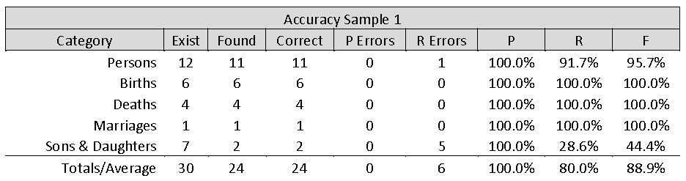
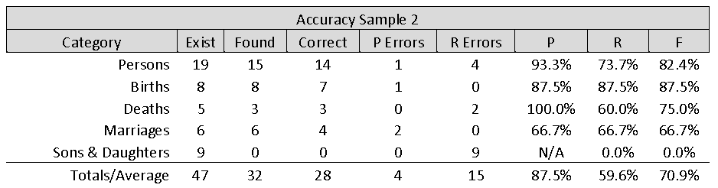
Results on Examples

Slide 15
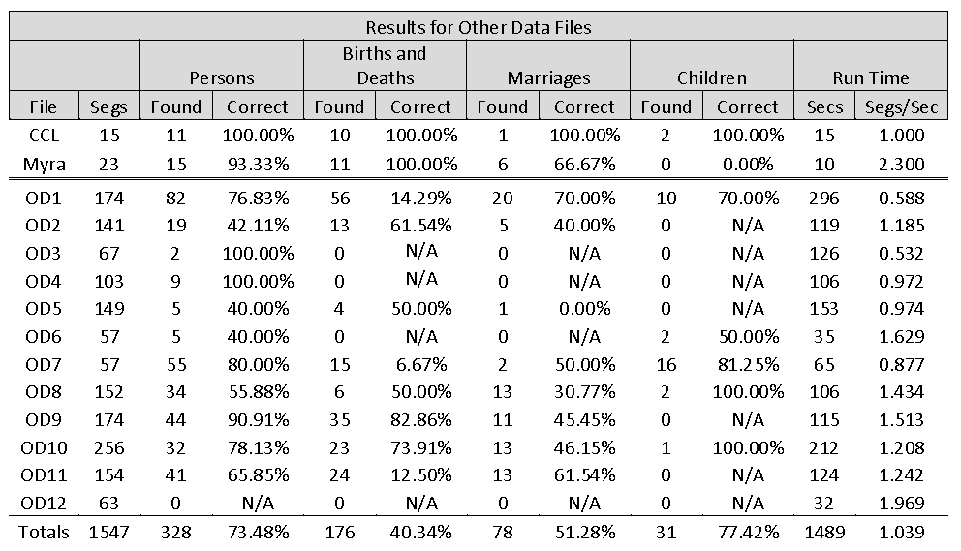
Results on Other Data

Slide 16
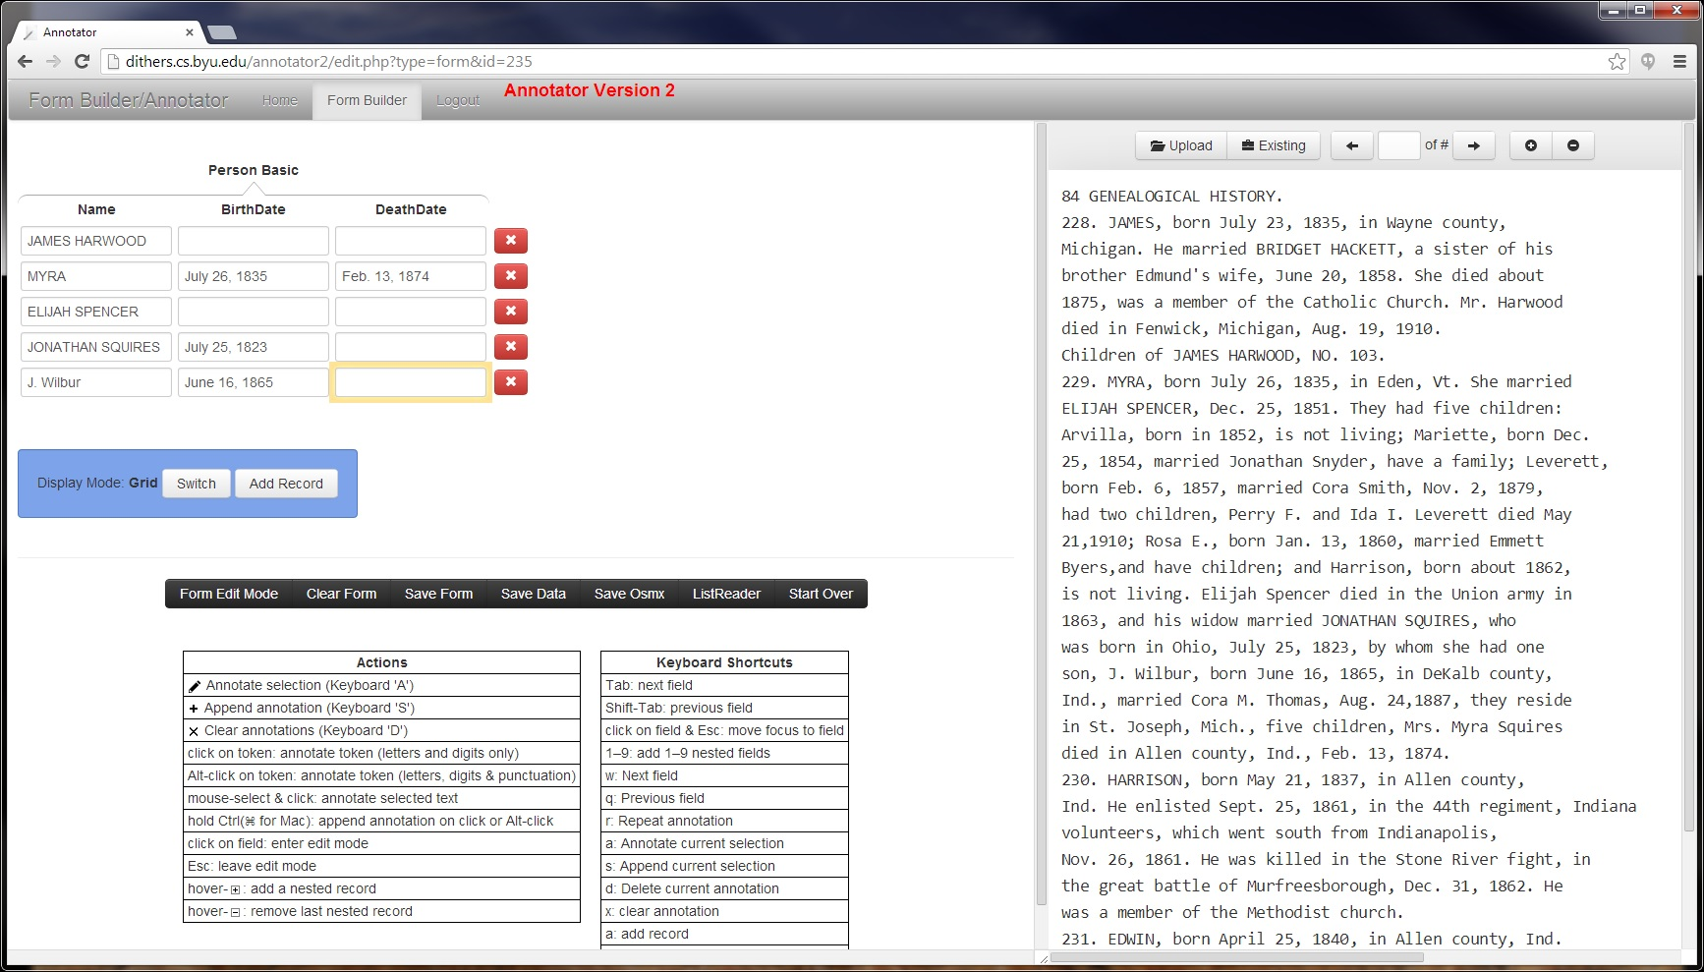
Possible Interactive Learning

Slide 17
Conclusions
It works! … and, it could work a lot better.
Nuggets
Coal
Segmenter
Adapted LG Parser
A construction grammar meaning analyzer
Mapped meaning schemas to user-defined ontologies
A single integrated processing pipeline
Evaluation on 12 randomly-selected pages
More constructions and world knowledge
Parser problems
Performance depends on document style
Named entity recognizer
Need an integrated incremental architecture
How to make the system learn its knowledge

Slide 18
Extras

Slide 19
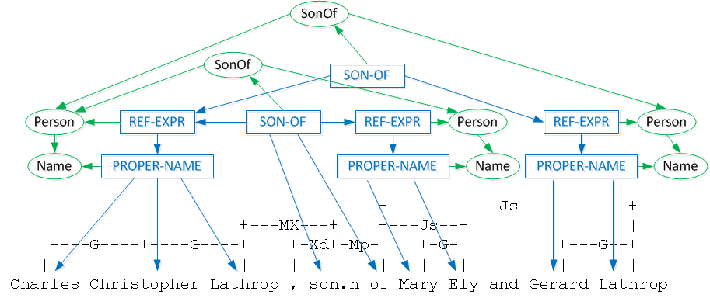
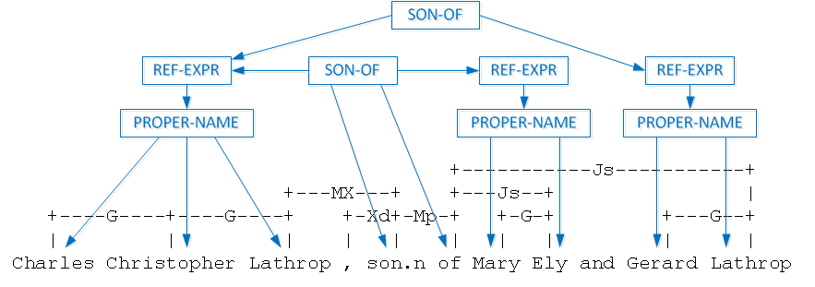
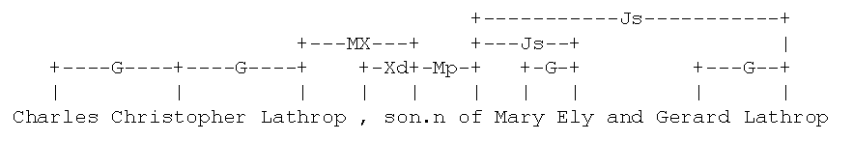
Linguistic Analysis – Case 1B
Charles Christopher Lathrop, … , son of Mary Ely and Gerard Lathrop ;

